Slide 1
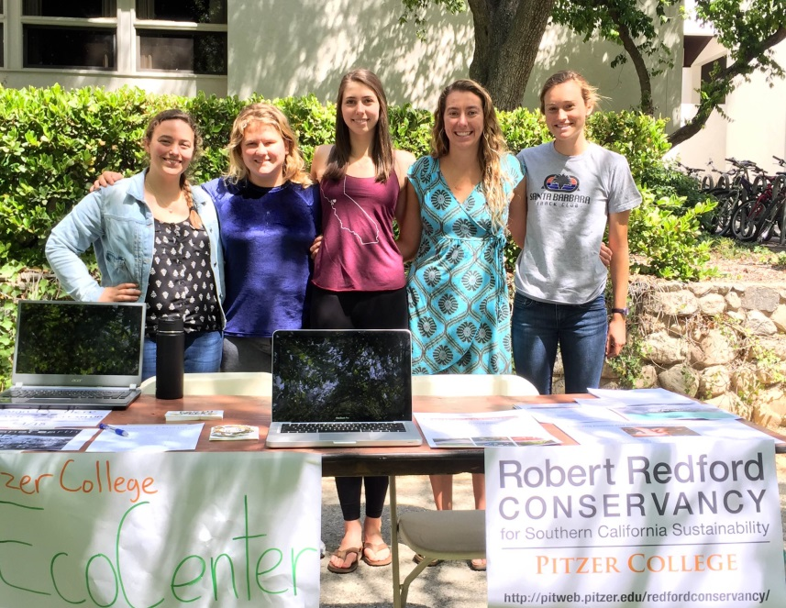
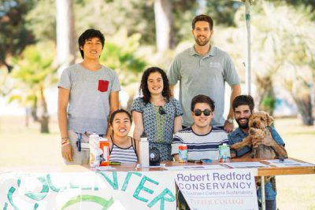
Sustainability At Pitzer College
Warren Biggins
Sustainability Manager | Pitzer College | GSC 201

Slide 2
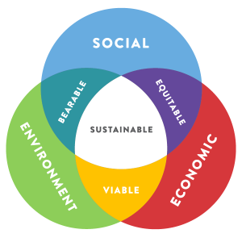
Defining Sustainability
“Development that meets the needs of the present without compromising the ability of future generations to meet their own needs”
Triple Bottom Line
People, Profit, Planet

Slide 3
Sustainability Leadership
Robert Redford Conservancy for Southern California Sustainability
Prof. Brinda Sarathy, Director
Office of Sustainability (GSC 201)
Warren Biggins, Sustainability Manager
Sustainability Committee
Student, staff and faculty representatives

Slide 4
Sustainability Reporting
Climate Leadership Commitment
Commits the College to achieving carbon neutrality
Requires annual GHG emissions reporting
Sustainability Tracking, Assessment & Rating System
Gold rating, 2015

Slide 5
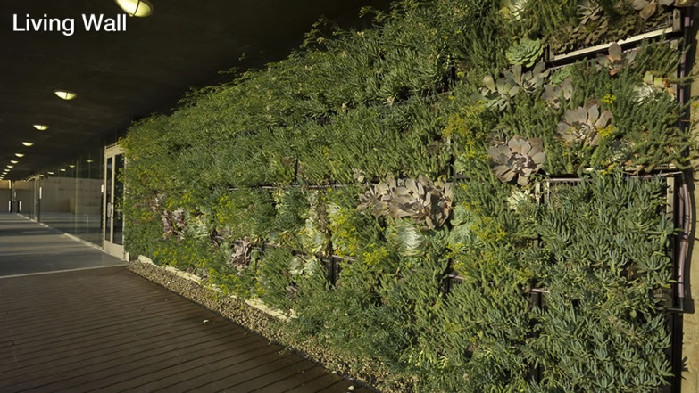
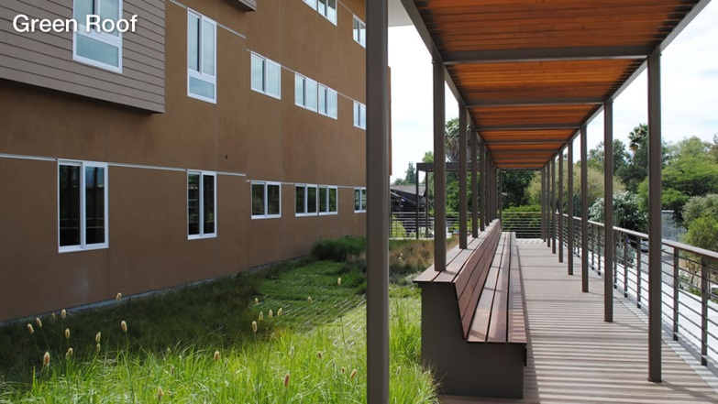
Green Building
Pitzer, Atherton & Sanborn
LEED Gold
East, West & Skandera
LEED Platinum
Redford Conservancy
LEED Platinum, Zero Energy (expected)

Slide 6
Getting Involved
Redford Conservancy
“Engaging peoples and
communities for regional
sustainability”
Become a Conservancy
Fellow
Attend a Conservancy sponsored event

Slide 7
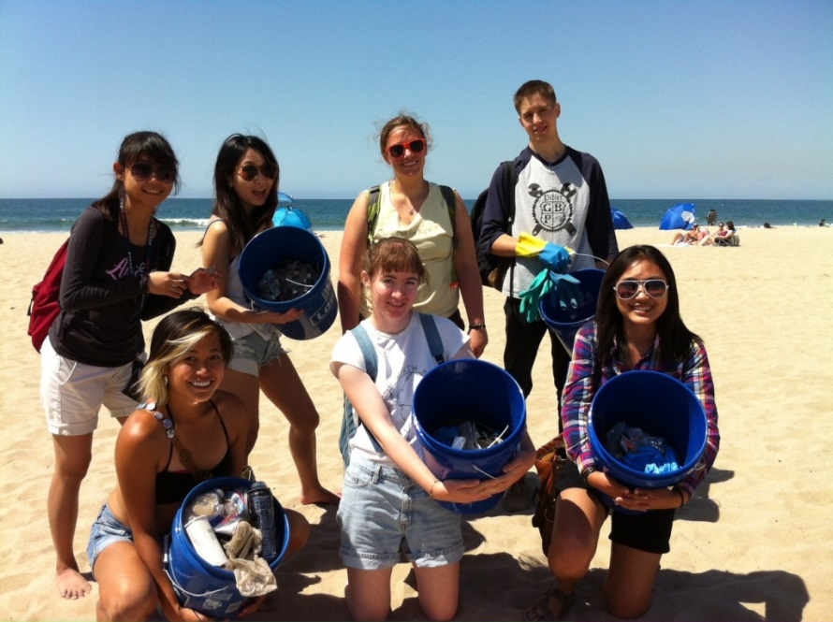
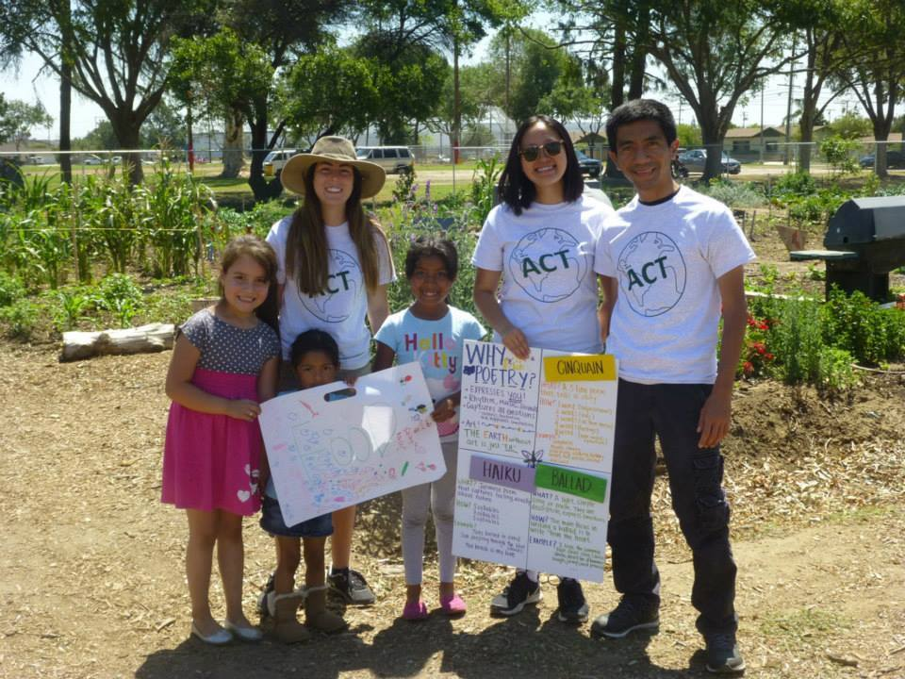
Getting Involved
Student Groups
A Cleaner Tomorrow
EcoCenter
Food Recovery Network
Garden Club
Green Bike Program
ReRoom Initiative
PowerDown competition
Student Senate
Environmental Rep

Slide 8
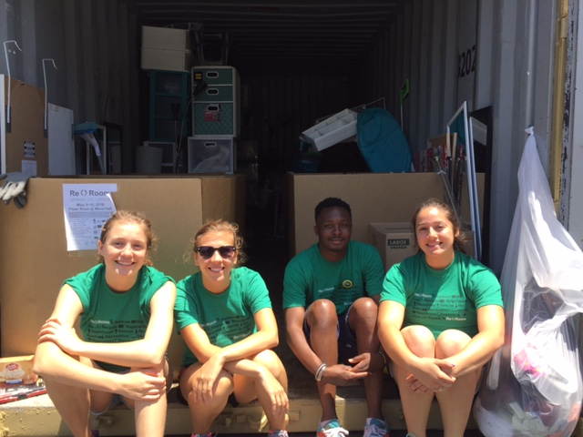
Getting Involved
ReRoom Initiative
Student-led initiative
Winter & spring donation collections
Fall sales to incoming & returning students
Food Recovery Network
Student-led food recovery from the dining hall
Donated over 1,700 pounds of food in the ’16 – ’17 school year
Food is donated to the Salvation Army in Ontario

Slide 9
Food Waste Composting
Pre & post-consumer food waste collection in the dining hall
15,000 pounds of food waste was composted in ’16 – ’17 school year
No napkins!
Empty compost bins in the garden

Slide 10
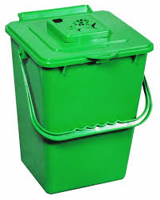
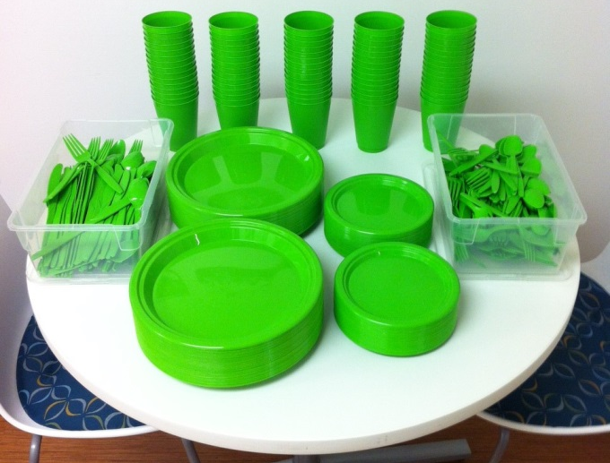
Resources
Available for check out
Compost bins
Drying racks
Green dishware

Slide 11
Stay Informed
Redford Conservancy homepage:
http://www.pitzer.edu/redfordconservancy/
Pitzer sustainability homepage:
http://www.pitzer.edu/sustainability/
On Twitter: @Sustainable PZ
The Green Guide: A Resource for
Sustainability at Pitzer College

Slide 12
Career Resources
Sustainability & environmental jobs board
http://www.pitzer.edu/sustainability/sustainability-job-board/
Pitzer College Environmental Professionals
LinkedIn group

